Slide 1
Hawaii

Slide 2
Pre-contact Hawaii
Each of the 8 inhabited islands were divided into separate districts known as Okana
Okana ran from the mountains to the sea
Each Okana was then sub divided into Ahupua’a
Ahupua’a also ran in wedge shaped pieces from the mountains to the sea

Slide 3
Each Ahupua’a was then fashioned into ili on which resided the Ohana (or extended families) who cultivated the land
The Ohana was the core economic unit in Hawaiian society
No currency
Thus there existed no idea of financial profit from exchange

Slide 4
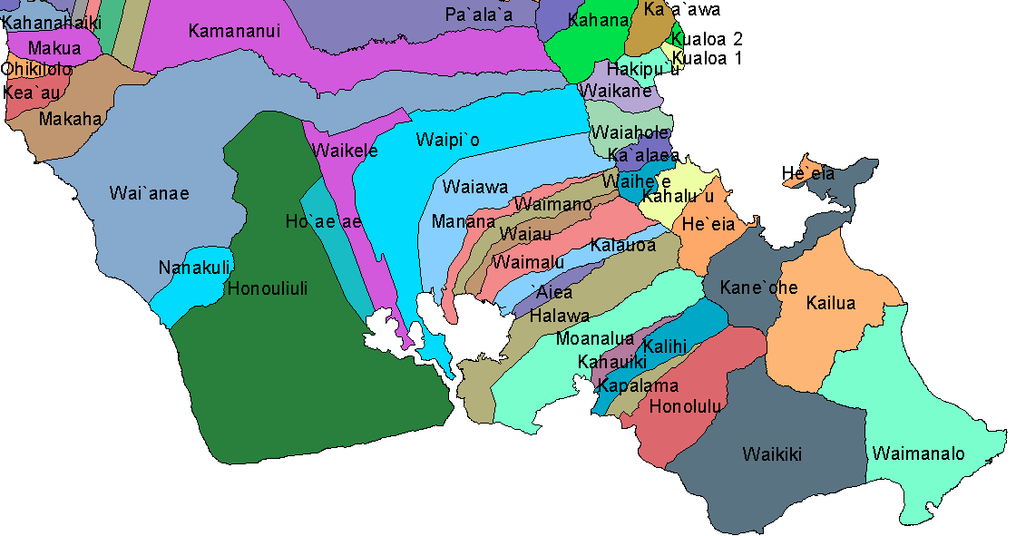

Slide 5
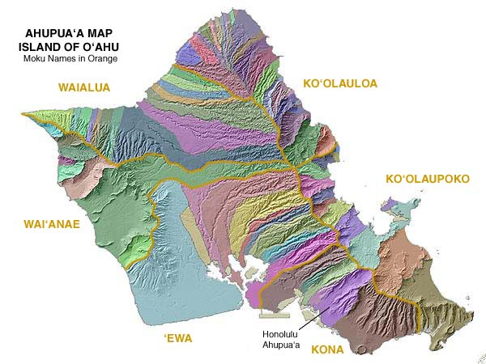

Slide 6
Exchange between Ohana who lived near the sea with Ohana who lived inland constituted the economic life of communities which densely populated the Hawaiian islands
Therefore, Kinship formed the economic base of Hawaiian society
Kinship also established the complex network of Ali’i (Chiefs)
The Ali’i competed with each other in terms of rank which was established by spiritual power or MANA
Mana was derived from chiefly genealogies or from conquest in war
Notes:
When the settlers came, they observed the Natives chopping up and boiling the bodies in which they had just killed. They were not cannibals but this was their way of getting to the manna of the generals. Somewhat of a sign of respect.

Slide 7
The highest ranking Ali’i were advised by a priestly class or KAHUNA
THe Maka’ainana (people of the land) made up the bulk of the population
They were subordinate to their ali’i caretakers but were independent in many ways
The Maka’ainana neither owed military service to the ali’i nor were they bound to the land
Notes:
No contracts

Slide 8
It was a system of interdependence
The Maka’ainana were free to move their ohana to live under an ali’i of their choosing
An Ali’i increased his status and material prosperity by having more people living within his Moku or domain
The result was an incentive for the society's leaders to provide for all their constituents well being and contentment- to fail to do so meant the loss of status and thus the loss of MANA for the ali’i
Notes:
Being nice to their residents was a good thing. There was no point of getting petty with your serfs as it would damage your reputation.

Slide 9
Moral order, or the code upon which determinations of right and wrong were based were part of the kapu or system of sacred law
The Kapu determined everything from the time of farming and war making to the correct mating behavior among ali’i and maka’ainana alike
The cosmos, like the natural world, was a universe of familial relations
Human beings were but one constituent link in the larger family
Thus gods had human as well as animal form and human ancestors inhabited different physical forms after death

Slide 10
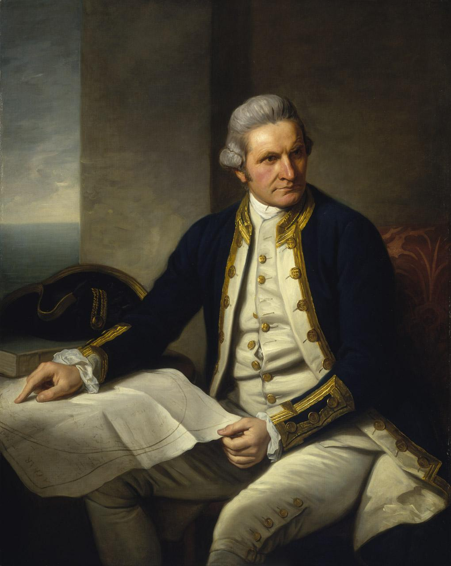
Hawaiian Cosmology
Nature was not objectified….it was personified which resulted in an extraordinary amount of respect for the life of the sea, the heavens and the earth
This is the world that Captain Cook met in 1778

Slide 11
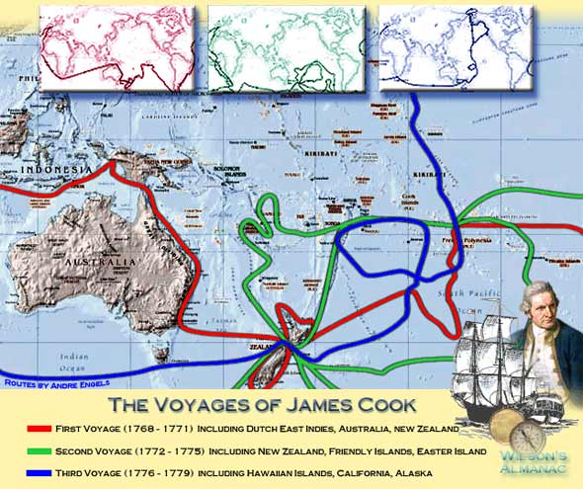

Slide 12
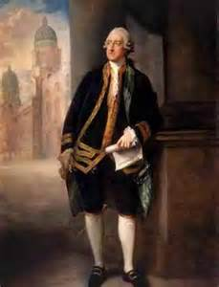
James Cook
British Naval Captain
He called the Hawaiian Islands “The Sandwich Islands” 1778
John Montagu 4th Earl
He is the first European to reach the Hawaiian Islands
He first landed at Waimea on the island of Kauai

Slide 13
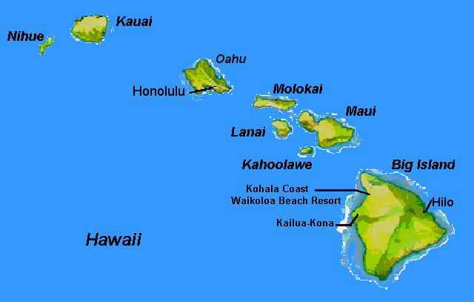

Slide 14
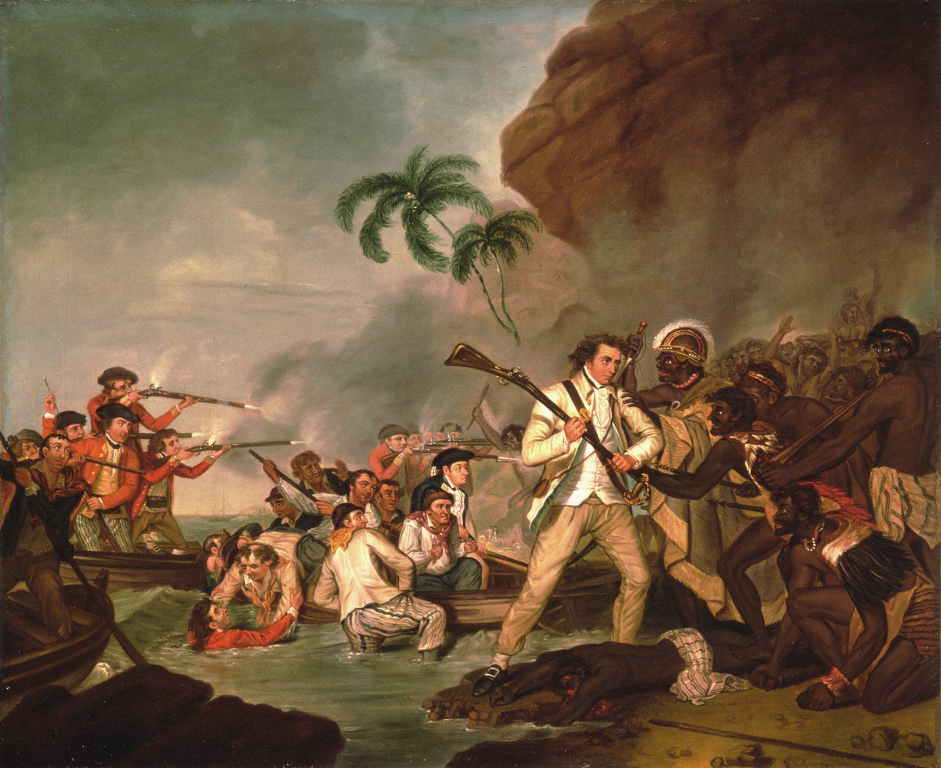
James Cook
He traveled to the Island of Hawaii on a return voyage
Tries to recover a stolen boat
Takes a high chief hostage
Captain Cook is stabbed to death in 1779

Slide 15
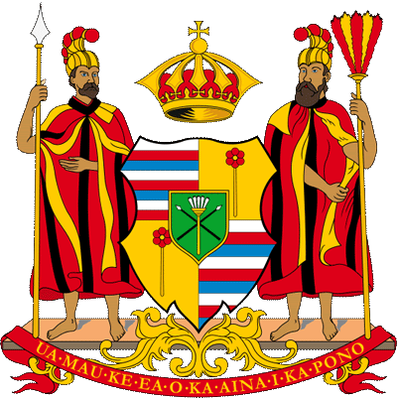
Kamehameha I ( The Great )
Kamehameha I conquers the Hawaiian islands
Unites the islands
Formally establishes the kingdom of Hawaii in 1810
He ruled until 1819

Slide 16
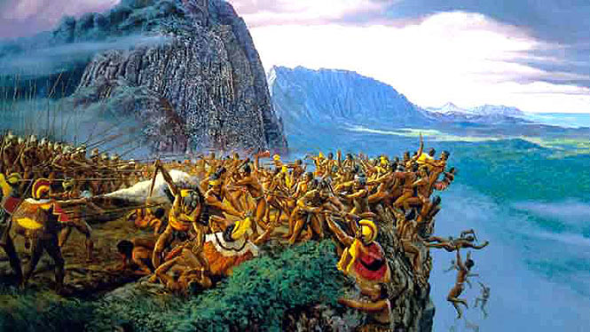

Slide 17
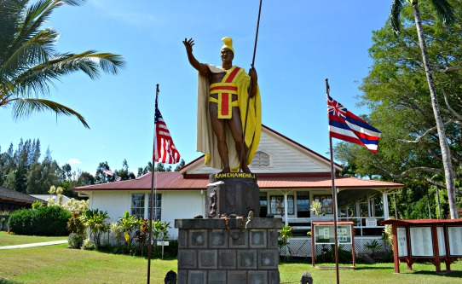
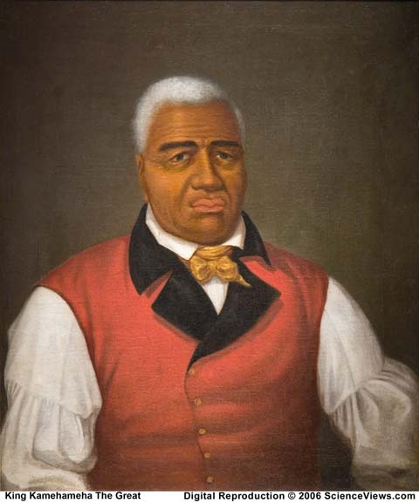
Notes:
He was really into the Western clothing as shown in this portrait.

Slide 18
Kamehameha II ruled 1819-1824
Kamehameha III ruled 1825-1854
Kamehameha IV ruled 1855-1863
Kamehameha V ruled 1863-1872
Lunahilo ruled 1873-1874
Kalakaua ruled 1874-1891
Liliuokalani ruled 1891-1893

Slide 19
Polynesian Triangle
Stretch of ocean between New Zealand, Easter Island and Hawaii
Each of the groups residing in these areas had related cultures, customs and dialects
Haole- first used to describe non native plants, animals and people
Now used as a description of non native peoples

Slide 20
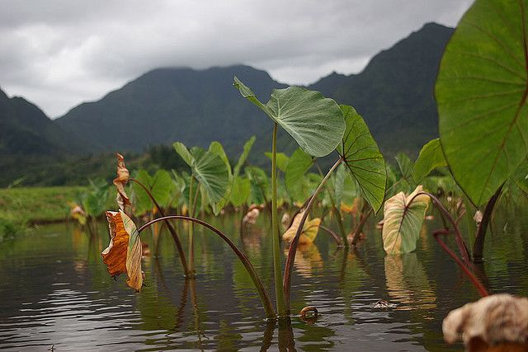
Taro- a root vegetable
But to ancient Hawaiians it was much more than just a plant…
…it was a brother
Earth mother mated with the Sky father
They had a daughter
Then the sky father mates with the daughter

Slide 21
The result is as still born baby
It is buried and the first Taro plant grows in this spot
It is called Kanaka (Human being)
The Taro plant then takes care of all Hawaiian people by providing sustenance for the Hawaiian people

Slide 22
Just prior to the first American missionaries showing up in Hawaii Kamehameha the Great dies
His son Liholiho becomes Kamehameha II
The Queen mother is Keopuolani (highest ranking noble in Hawaii)
Her parents were siblings
Brother and sister marriages were prized for concentrating a clans spiritual power or MANA
Therefore a suitable partner for a Hawaiian Chief was his sister
This paring is called a PIO (meaning a bow, a loop or something bent in on itself)
Notes:
Couples that were brother and sister meant that their children would have great mana. If someone was the same rank but their parents didn’t fit the description, they would still be seen as having less mana.

Slide 23
The offspring of this type of union would be a chief of the highest rank
The people of this type of union were called AKUA
Following Captain Cook increased numbers of westerners arrived in the islands and with them they brought
Capitalism
Western political ideas
Christianity
disease
Notes:
The natives played it quite smart as they did not allow themselves to be completely drawn into the new culture, they slowly adopted it.

Slide 24
In just over a hundred years after Cook’s arrival the Hawaiian society changed dramatically
Traditional Hawaiian religion gave way to Christianity
The Hawaiian moral order KAPU changed
The Chiefly form of government was lost
Ultimately Hawaiian Kingdom and sovereignty was lost
Hawaiian culture was significantly changed and at times suppressed

Slide 25
It is estimated that anywhere between 300,000 to 1 million Hawaiians inhabited the islands pre 1778
By 1840 diseases had taken such a toll that the population was reduced to less than 100,000
By 1890 there were less than 40,000 native Hawaiians

Slide 26
Western missionaries arrive in the 1820s
Traders and merchants interested in Sandalwood
Whalers
In 1839 French Catholic priests arrived and attempt to establish a mission
This was opposed by the anti-Catholic Calvinists (missionaries from New England)
By this time the New England missionaries had become advisors to the Moi or Monarch
So the Catholic priests are sent away

Slide 27
Then in July 1839 a French Warship arrived in Honolulu and made several demands
1-French priests are to be allowed to establish a mission
2- that a land grant be established for such a mission
3- the Hawaiian government pay ($20,000)
If the demands were not met they would declare war on Hawaii
The demands were met
This incident impressed on Kamehameha III that Hawaii was vulnerable to the great western powers ( France, Great Britain, United States)

Slide 28
King Kamehameha III realized that certain steps were needed in order for Hawaiian sovereignty to be recognized and for Hawaii to be less vulnerable to colonization
So later in 1839 he issues the HAWAIIAN DECLARATION OF RIGHTS
Hawaii was an absolute Monarchy before this act
So this was a movement away from an absolute monarchy to a constitutional monarchy
The Hawaiian Declaration of Rights served as the pre-amble to the Hawaiian Constitution of 1840
The Hawaiian Constitution Established a House of Nobles (comprised of Chiefs) and an elected Legislature to pass laws in concert with the Nobles
Hawaiian Representatives traveled to the United States, Great Britain and France to obtain recognition of Hawaiian Independence
Notes:
The US sort of acknowledged their independence as it was a verbal but not in writing. Both France and England wrote it down

Slide 29
While the Hawaiian representatives were on their journey to secure international recognition for Hawaii the British Consul became involved in a land dispute
Lord George Paulet (A British Naval Commander) demanded land in Hawaii and threatened war
Under protest the Moi (monarch) Kamehameha III provisionally ceded the sovereignty of Hawaii to Paulet until Queen Victoria could be appraised of the conflict
When the Queen found out she disavowed Paulet’s actions and restored Hawaii’s sovereignty ( July 31, 1843)
For the next 50 years this was celebrated in Hawaii as Restoration Day

Slide 30
Meanwhile…the Hawaiian representative that journeyed to the United States received a verbal (but not written) agreement to respect Hawaiian sovereignty from President John Tyler
On November 28, 1843 Hawaiian representatives obtained signatures of officials from both Great Britain and France that recognized Hawaii as an independent nation and a member of the family of nations
November 28 was then officially celebrated as Independence Day in Hawaii

Slide 31
The point- the Hawaiian Moi changed the Hawaiian form of governance to resemble a western government and sought international recognition in order to suppress further acts of colonization and Imperialism
Hawaii also established embassies in foreign countries including the United States, Great Britain and France
In order to better understand western governments Hawaiian Kings began to employ the assistance of American born advisors (missionaries and their descendants) in the government

Slide 32
Between 1848-50 King Kamehameha III gave in to Haole advisors and institutes the Mahele system
The Mahele system – or division of lands meant that…
No longer would the land be divided up into OKANA (districts of land running from the mountains to the sea)
No longer would the OKANA be subdivided into AHUPUA’A
No longer would the OHANA cultivate the land in the same way
No longer would the OHANA be the core economic unit in Hawaii
Instead the OKANA system would be dissolved and the MAHELE system instituted

Slide 33
MAHELE
Under the Mahele system for the first time HAOLE or foreigners were allowed to own land
Just prior to this remember that the King shifted the monarchy to a constitutional monarchy to resemble a western government
As Hawaii made this shift Haole’s were allowed to participate in the governance of Hawaii
Around 1845 (1845-1847) Something called the ORGANIC ACTS were drawn up by newly appointed Attorney General JOHN RICORD (A New York lawyer that arrived in Hawaii in 1844)
The provisions of the Organic Acts provided separate departments or ministries under the king to be staffed by senior government officials known as…

Slide 34
ORGANIC ACTS
The Ministry of the Interior
The Ministry of Foreign Affairs
The Ministry of Public Education
The Ministry of the Treasury
More importantly these ministers replaced various functions of the executive (Moi or the King) theoretically leaving the King to oversee them all
3 of the first 4 Ministers were HAOLE
2 of them had come to Hawaii as missionaries

Slide 35
While the Moi or King’s intentions were good and he was employing the assistance of foreign born officials in his government to help in the transition from an Indigenous form of governance to a western form…
…his decision was not trusted by the MAKA’AINANA
Theoretically the HOUSE OF NOBLES or ALI’I and the elected legislature were to make laws together it became clear that the Haole first ministers had replaced the Ali’I as the principle authorities in government (besides the king)
When the Okana system was replaced by individual land ownership the Maka’ainana lost out

Slide 36
With this change the Moi possessed more than 1 million acres of the kingdoms 4.2 million acres of land
251 individual Ali’I owned about 1 million acres
The 80,000 Maka’ainana owned 28,000 acres in total
The remaining amount was now secured by Haoles

Slide 37
In 1853 there was a smallpox epidemic that devastated the native population
This meant that the labor needed to maintain the Taro patches began to disappear
During the process of selling the land to individuals the commoners lost out because
1-many of them perished in the 1853 epidemic
2-some chose not to make claims because it would alter their traditional status and traditional rights (in terms of land usage) under the Okana system
3-Because they could not pay the surveyors fees which were significant and for a people who did not operate in a capitalist system with real money – so the fees were too costly
Even if they could afford to pay the surveyor the typical land award was between 3 and 10 acres
3-10 acres was a significant reduction in workable land for the OHANA

Slide 38
The way that the land was divided up in the Okana system each Taro farmer had access to the water that ran down from the mountains to the sea and irrigated their crops
With the Mahele system they did not have this because new irrigation systems were built which allowed for the Haole to secure most of the water rights
This would be significant when Haole land holders capitalized on the United States need for sugar after the civil war began
The Taro fields once controlled by the maka’ainana were replaced by sugar plantations owned by the Haole
The Haole then replace the Maka’ainana as the owners of the land

Slide 39
Haole sugar plantation owners wanted to capitalize on the American market however since Hawaii was a sovereign nation they had to pay the US Sugar Tariffs or taxes
In the 1850s the advisors or first ministers of the king wanted Hawaii to become part of the United States so they would not have to pay these tariffs
With that in mind the advisors drafted an annexation treaty in the 1850s
However King Kamehameha III opposed this treaty and it remained unsigned by him at his death
His successor Prince Alexander Liholiho (Kamehameha IV) ascended to the throne in 1855 and he terminated ongoing negotiations for annexations to the United States
Shortly thereafter the Hawaiian sugar planters experienced a boom in sugar profits between 1857 and 1867 caused by the ban on southern sugar in the northern states during the Civil War
This delayed the urgency for the planters to have the USA annex Hawaii

Slide 40
Kamehameha IV died in 1863
His brother Prince Lot (Kamehameha V) succeeded him and was also a strong advocate for Hawaiian Independence
In order to fend off US annexation Kamehameha V continued something his brother started called the Reciprocity Treaty
This provided certain trading rights to the US in order for them to attain Hawaiian sugar
The planters were paid handsomely and Hawaii ensured its sovereignty
However in the 1860s the New US minister to Hawaii ( James McBride) suggested that with the reciprocity treaty Hawaii needed to cede a port in Honolulu to the US

Slide 41
James McBride also sought the permanent stationing of a US warship in Hawaiian waters to guard American economic interests
In 1866 the USS Lackawanna was assigned to the island for an indefinite period
This protection of US economic interests with military might was an extension of the Manifest Destiny policy that Americans had practiced on the continent
The New York Times in 1868 stated that the United States was bound within a short time to become the great commercial and controlling power in the Pacific
But the biggest push for annexation was not from the USA but rather from the Haole sugar planters in Hawaii

Slide 42
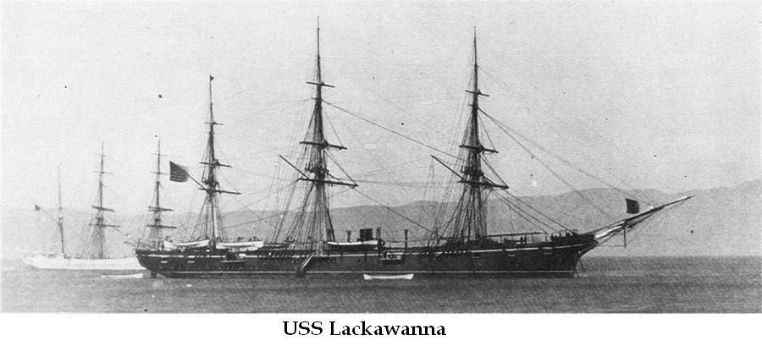

Slide 43
aw
In 1869 Henry Pierce became the US minister to Hawaii and immediately urged the cession of the Pearl River Lagoon as a naval station in exchange for a Reciprocity Treaty
Kamehameha V died in 1872 and his successor William Lunalilo gave in to his ministers urging and reluctantly agreed to negotiate a Reciprocity Treaty that included the cession of the Pearl River lagoon
The advisor that pushed Lunalilo the most was Charles Bishop
Charles Bishop was working with an American- General Schofield and advocated the US defense of their Pacific coast relied on the establishment of a naval base in Hawaii

Slide 44
Both Bishop and General Schofield were disappointed when Lunalilo reversed his decision
The Native Hawaiian public outcry against any cession of Hawaiian land convinced the king that he would receive no support from the native population for his action if he ceded the area for a base
The Native population felt that any cession of Hawaiian territory to a foreign nation would simply be a prelude to annexation
Literacy –Newspapers
Native Hawaiians argued and felt that annexation would be national death

Slide 45
Furthermore, Native Hawaiians expressed through the newspapers that the Hawaiians would suffer virtual enslavement under annexation
They cited the treatment of American Indians and African peoples in the United States as the prelude for what was to come if they agreed to annexation
Therefore Native Hawaiians rigorously opposed any talks of annexation or land cession
Lunalilo had no sooner changed his mind when he contracted tuberculosis and died in 1874
His reign lasted less than 13 months

Slide 46
While debates over the threat to Hawaiian sovereignty raged in the papers and immediate menace to Native Independence was posed by the constant interference of US naval forces to quell disturbances in the city of Honolulu
Since the early 19th century the presence of whalers and merchants in the towns such as Honolulu meant an increase in civil disturbances
Alcohol and prostitution exacerbated the problem
Therefore peacekeeping was an excuse for the continued military presence
US warships were there to protect US interests and when political disturbances threatened to disrupt the sugar industry the US military intervened
Just such a political disturbance arose when Lunalilo died and David Kalakaua ran in an election against the dowager Queen Emma for Moi

Slide 47
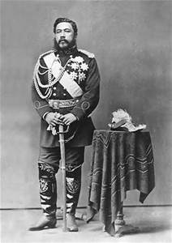
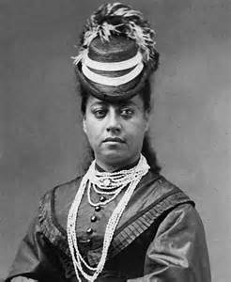
Notes:
David was not very popular with the native Hawaiians because he was pro-American and they were very weary about the prospect of American interests in Hawaii. To them, this was one step closer to being colonized. Queen Emma was pro British and was the Hawaiian’s pick and the popular majority.

Slide 48
Kalakaua’s and Emma’s supporters engaged in a brief conflict that precipitated the landing of United States Marines
Ostensibly they were there to maintain order but in reality they were there to support the pro American candidate Kalakaua against the pro British candidate Emma
With American intervention and support Kalakaua became King
In return for their support Kalakaua concluded forty years of negotiation of the Reciprocity Treaty ( 1875)
What did this mean?
It brought immediate relief to the sugar industry, in fact it brought a boom
Sugar exports to the US went from 17 million pounds in 1875 to 115 million pounds in 1883

Slide 49
Of the 32 plantations that dominated the Hawaiian economy 25 were American or Haole owned
While the Treaty brought a boost to the sugar industry it also brought a flood of foreign immigrants to work the sugar plantations
Between 1877-1890 55,000 new immigrants arrived in Hawaii to work in the sugar industry
During the same period the Native Hawaiian population was halved
By 1890 Native Hawaiians made up less than half (45%) the population
Haole and Asians made up 55%

Slide 50
Most of the profits from the sugar industry went into the hands of American planters
A group formed called the Hawaiian League (made up of all Haole businessmen)
They formed in order to protect the interests of the Haole property owners
The Hawaiian League forced King Kalakua at gunpoint to sign a treaty dubbed the Bayonet Constitution in 1887 that ceded the Pearl River lagoon to the United States in exchange for duty free sugar trade for the Haole plantation owners
This meant that the planters would no longer have to pay Tariffs to the US
The Bayonet Constitution also stipulated that the ministry was no longer responsible to the king – instead they were responsible to the legislature

Slide 51
Then in order to ensure Haole domination of the legislature the electorate was severely restricted by income qualifications
You could now only vote in Hawaii if you owned $3,000 worth of property
This was a way to exclude the Native Hawaiians from the right to vote
The result was that the missionary descendants (Haole businessmen) secured control of the legislature
The most powerful group in the kingdom was now the cabinet minsters and the legislature which were practically all Haole
In addition, suffrage or voting rights were granted to foreigners willing to swear allegiance to the new government

Slide 52
After the Bayonet Constitution, racist arguments about Native Hawaiians cultural inferiority and economic inability appeared daily in the Haole controlled newspapers
Racial inferiority was used to justify the seizure of power and the calls for annexation
Kalakaua died in 1891 and was succeeded by his sister Lili’uokalani
Enraged by the action of the Haole planters Hawaiians revolted, they were seeking to revise the Bayonet Constitution- once again American troops landed to restore order
Lili’uokalani was determined to return her people to their rightful place in their own land
To that end the Queen decided to give her people a new and more democratic constitution – one that removed the property requirements for voters and restricted the vote to subjects of the Kingdom
Foreigners would not be allowed to vote

Slide 53
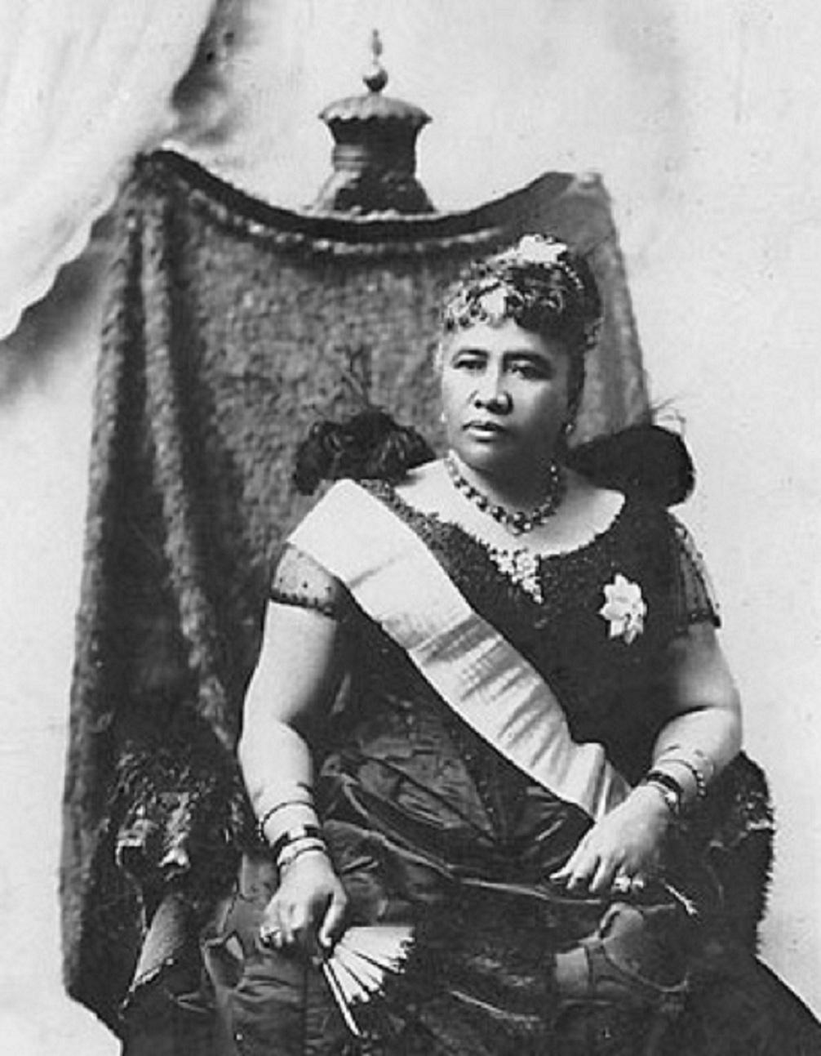

Slide 54
But Lili’uokalani was thwarted by her ministers
Her ministers formed the “Committee of Safety” an all Haole regime and sought military assistance from US marines by asking them to land and recognize the Haole provisional government
This was a planned takeover of the government
The marines marched to Iolani palace and the “Committee of safety” or the provisional government confronted the Queen
Faced with armed troops the Queen ceded her authority not to the provisional government but not the United States on January 7, 1893

Slide 55
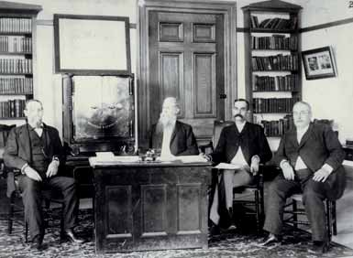

Slide 56
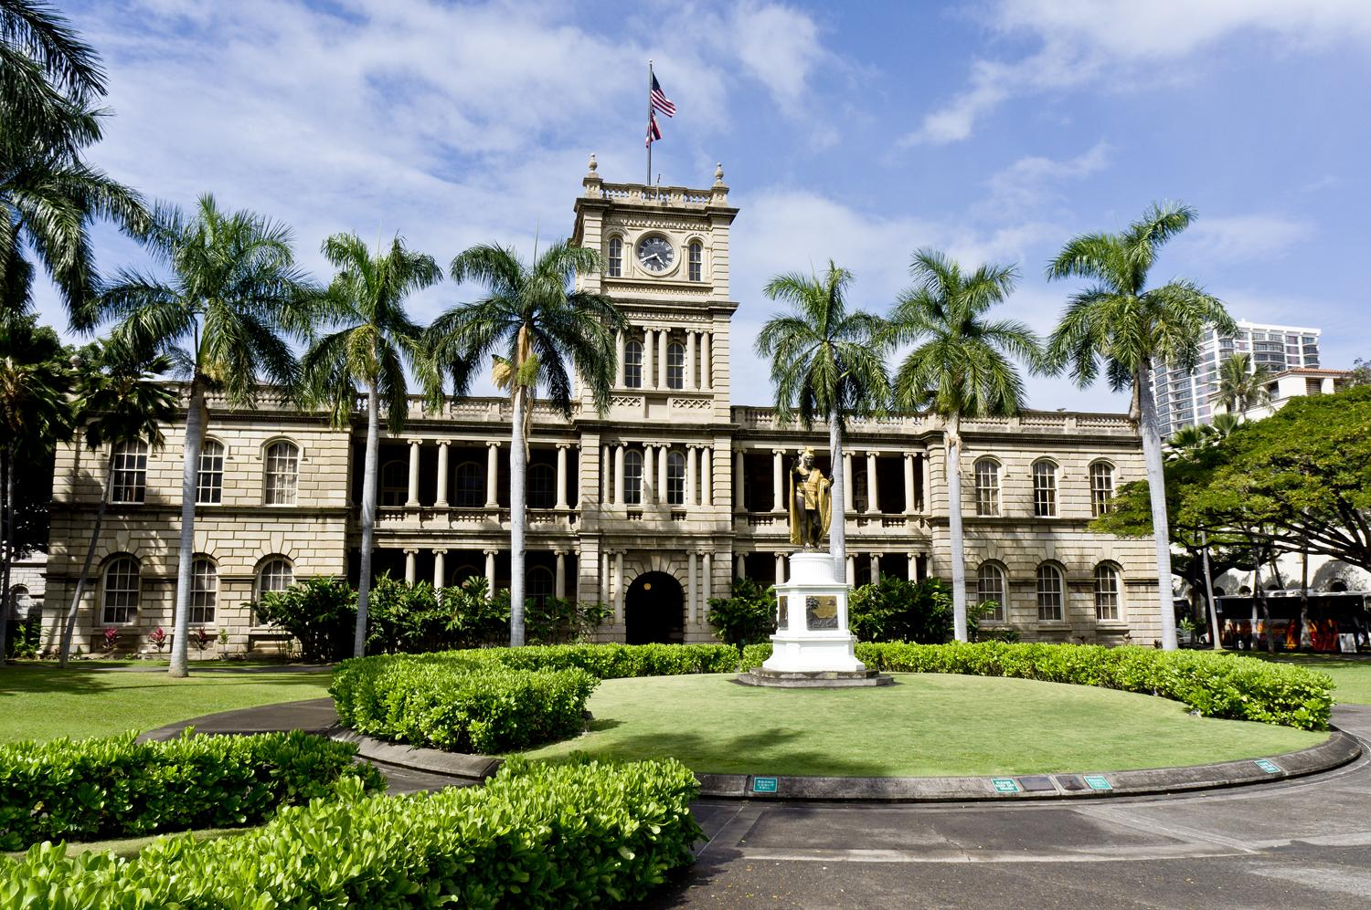

Slide 57
The Queen ceded her authority under protest
Until such time as the government of the United States shall upon hearing the facts undo this action and restore her to power
On February 1, 1893 the US minister to Hawaii proclaimed Hawaii a US protectorate and raised the American Flag over Iolani Palace
But the idea of swift annexation was short lived
President Grover Cleveland just 5 days after his inauguration withdrew the pending annexation treaty from Congress
On March 29 Cleveland’s commissioner James Blount arrived in Hawaii to investigate the overthrow
Blount’s report found the US and its minister guilty on all counts
President Cleveland upon reading the report explained to congress that he would never again submit an annexation treaty to them

Slide 58
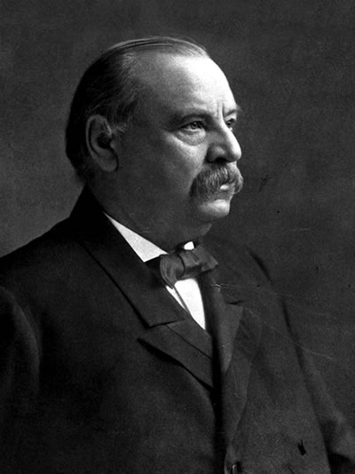
President Cleveland told Congress “By an act of war committed with the participation of a diplomatic representative of the USA and without authority of congress the government of a feeble but friendly and confiding people has been overthrown. A substantial wrong has thus been done which a due regard for our national character as well as the rights of the injured people requires we should endeavor to repair”

Slide 59
But Cleveland left office after one term
Lili’uokalani was never restored
She was instead imprisoned in her palace by the Haole planters
The all Haole provisional government became an Oligarchy (A form of government which all power is vested in a few persons in a dominant class)
They renamed Hawaii the Republic of Hawaii
In this new Republic voting was restricted to certain property requirements which excluded most native Hawaiians
Final annexation had to wait but it came in 1898 under President William Mckinley

Slide 60
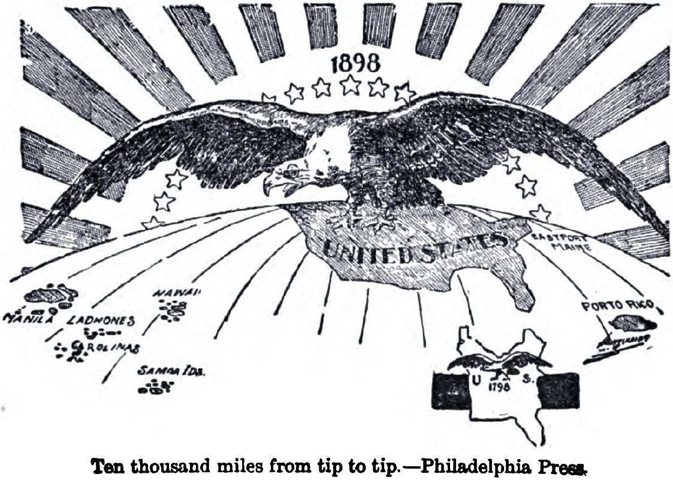

Slide 61
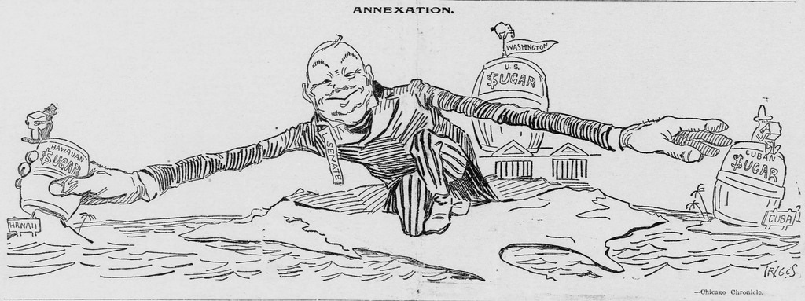

Slide 62
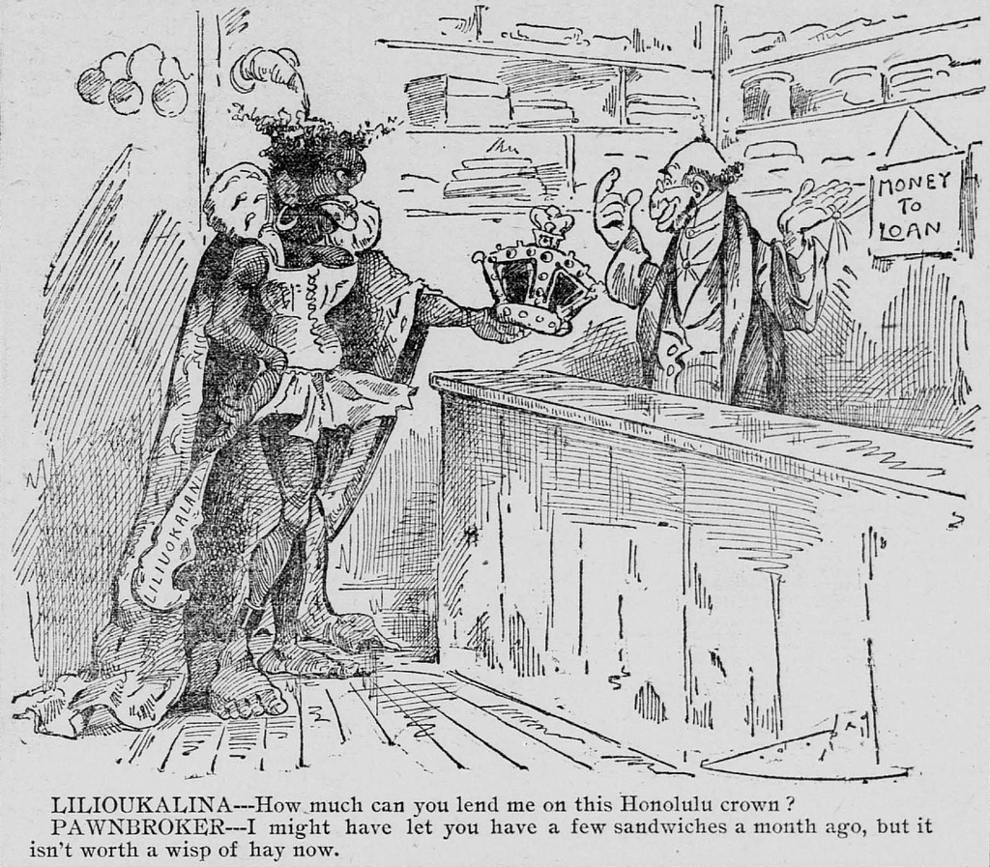

Slide 63
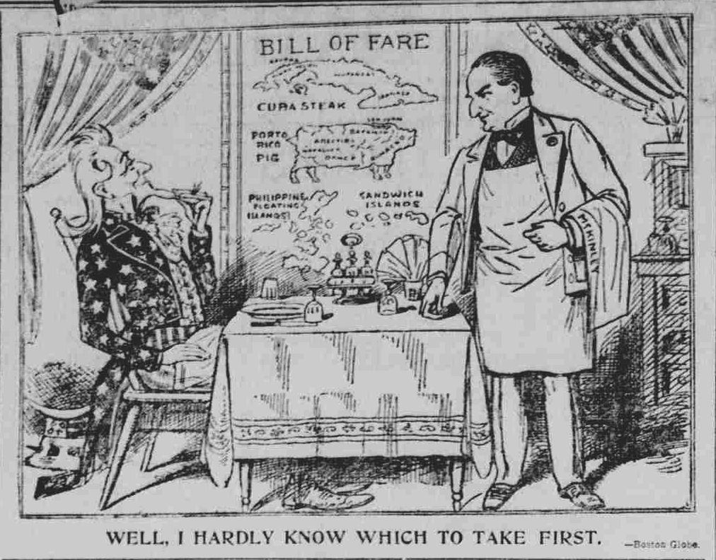

Slide 64
